Slide 1

FARSHORE
Odysseus took twenty years to get home.
You try to get him there faster.
CMPS 4200 · PHASE 1 · BIBEK PATHAK · SOLO
Notes:
You are not Odysseus. You are the voice in his ear, and he does not always listen.

Slide 2

THE IDEA
Every AI app: it advises, you decide.
Farshore: you advise, it decides.
How you say it changes his answer.
"Do not open the bag."
"You are almost home. Do not risk it."
SOUNDS LIKE AN ORDER
SOUNDS LIKE A FRIEND
He refuses. You lose nine months.
He listens. You save time.
Odysseus is proud. Order him around and he says no.
Notes:
This is the whole project in one slide. The flip, and why tone matters.

Slide 3
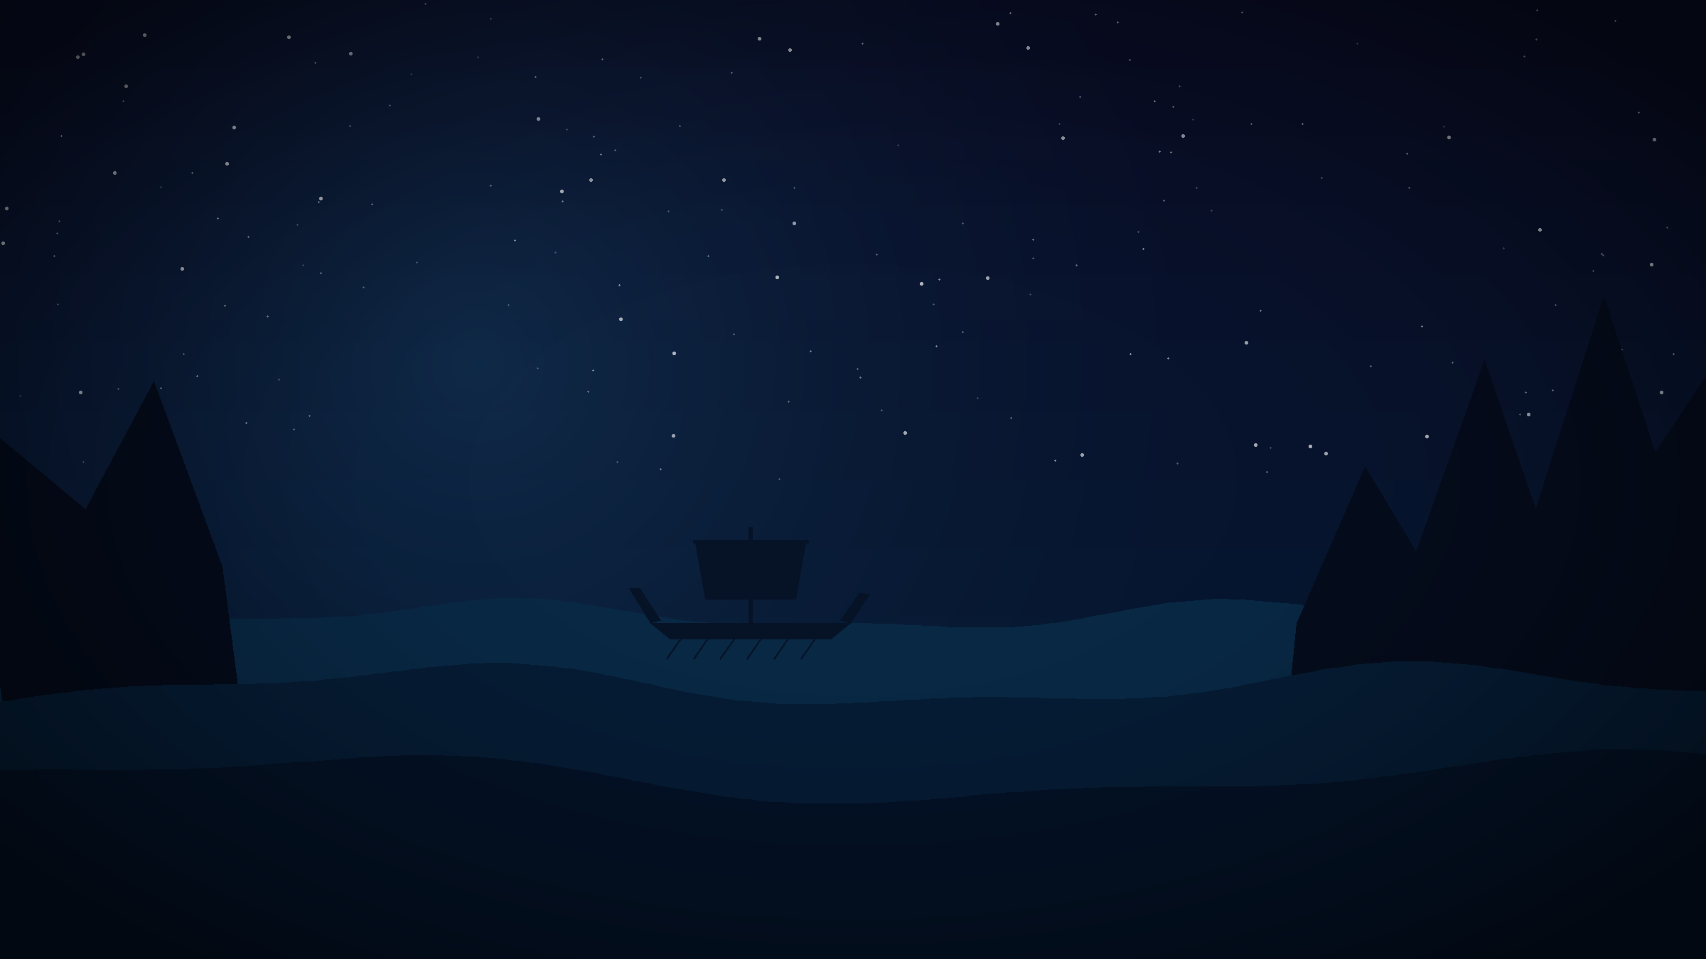
HOW IT WORKS
You talk. He decides. Time passes.
1
2
3
4
A problem appears
You speak
He chooses
Time is lost
Sirens ahead. A stranger offers food.
You say what you would really say.
He may agree. He may ignore you.
Weeks, months, or years.
20
Odysseus needed twenty years. That is the score to beat.
Notes:
The twenty year target comes from the poem itself.

Slide 4
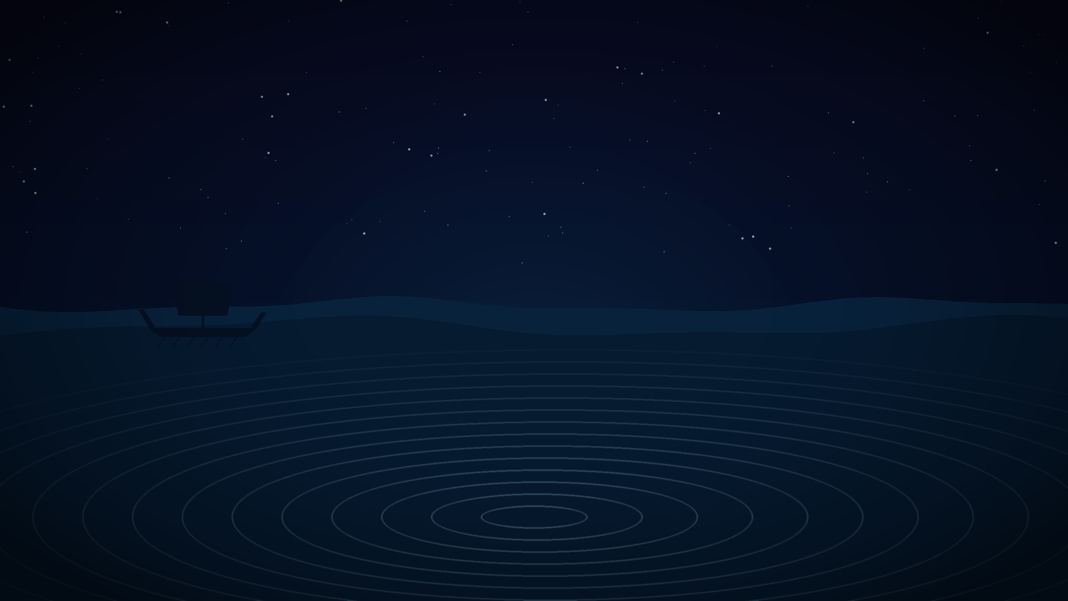
WHAT IT DOES, AND WHO FOR
Six features. Three kinds of player.
SIX FEATURES
THREE PLAYERS
Speak freely. No menus.
He has a personality: pride, curiosity, loyalty.
Trust goes up and down as you are right or wrong.
A clock that runs out.
New problems every game.
A report at the end of every time he ignored you.
Maya, 21
Gamer. Wants to win fast. Will be angry if it feels unfair.
Daniel, 19
Read the poem, never felt it. Not technical.
Rosa, 34
Does not trust AI. Wants to see why it said no.
I am working alone, so features 1, 2 and 4 come first. Six interviews are booked to check the three players.
Notes:
Say plainly: the three players are guesses. Interviews are booked, not done.

Slide 5

AI MODEL RESEARCH
Six models tested. Five chosen.
Llama 3.2 3B
Plays Odysseus and writes what happens.
2.5 GB
faster-whisper
Turns my speech into text.
1.0 GB
SER-Odyssey
Reads the feeling in my voice.
1.5 GB
all-MiniLM-L6-v2
Works out what my advice meant.
0.15 GB
Piper / VITS
Gives Odysseus a voice.
0.2 GB
bart-large-mnli
Tested for tone. Too slow, so not used.
SET ASIDE
All six are from our class lecture. All free. SER-Odyssey is on lecture slide 60.
Notes:
Point at SER-Odyssey and say slide 60. He put a model with Odysseus in the name in his own lecture.

Slide 6
CAN MY LAPTOP RUN IT
Yes. I checked the numbers.
My laptop
Intel Core Ultra 5, 16 GB RAM
All five models together
About 10 GB. It fits.
Llama 3.1 8B
Too big. I chose the 3B version instead.
Waiting time per turn
Under one second
I prepare both possible answers while the player is still thinking, so there is almost no waiting.
Notes:
Most students never check if their project can actually run. Say that you did.

